Slide 1


Wacky Races
Formula 1 – Data Analysis (2015 - 2022)
Group P3I
Programming for Data Science
2022

Slide 2

Table of Contents
Introduction
Collecting Data
data analysis
Programming for Data Science
2022

Slide 3

Why Formula 1?
Because we love it!
because F1 is the highest class of single seater racing cars motor sport
Because F1 has the fastest regulated road-course racing cars in the world
Because we wanted to have fun!
Programming for Data Science
2022

Slide 4

It’s all about
explore f1 data
global stats
identify correlations
Create visualizations
Discover new ways of working with python
Programming for Data Science
2022

Slide 5
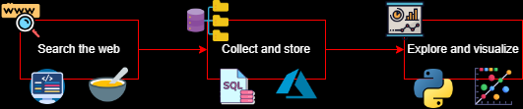
Collecting data
Programming for Data Science
2022

Slide 6
Data overview
**mapa**
Programming for Data Science
2022

Slide 7

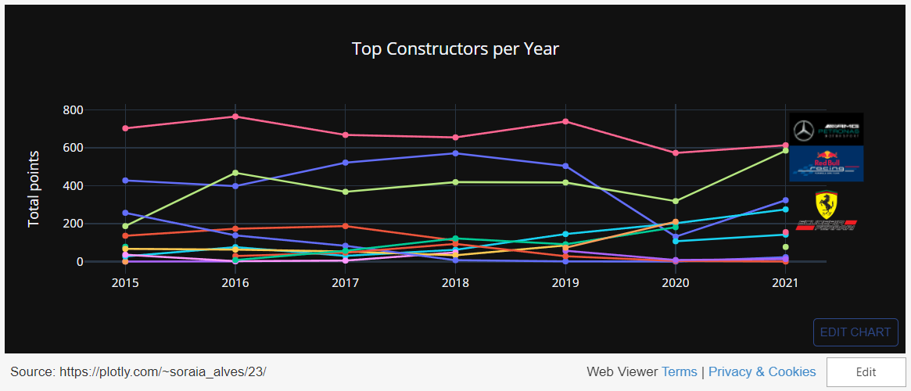
Who has been the dominant F1 team?
Programming for Data Science
2022

Slide 8

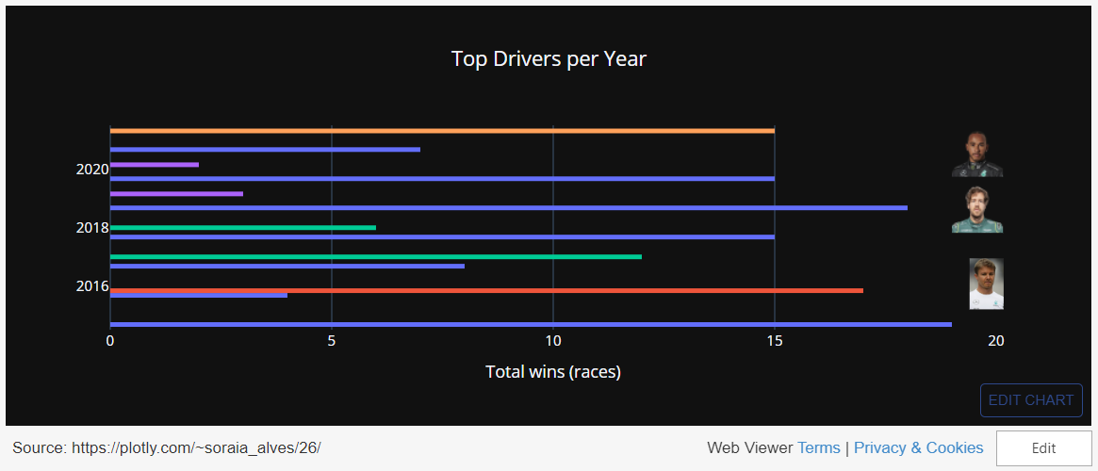
Who has been the dominant F1 Driver?
Programming for Data Science
2022

Slide 9

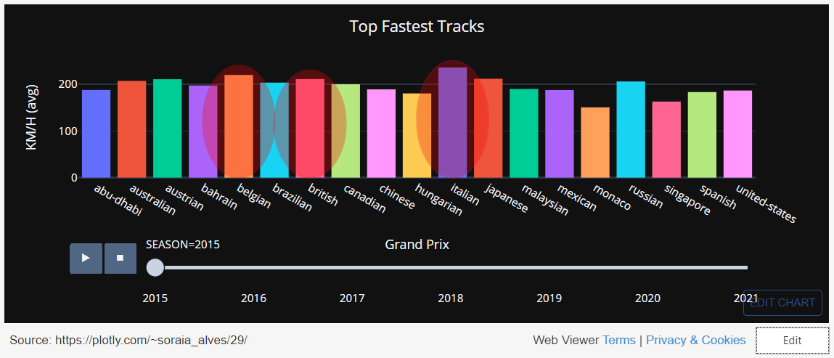
Which is the fastest F1 track?
Programming for Data Science
2022

Slide 10

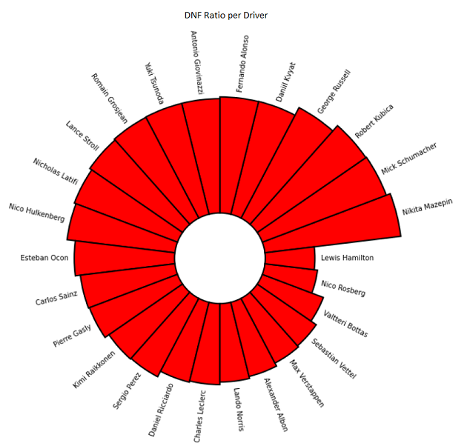
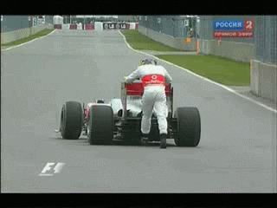

Addicted to Safety cars!
Programming for Data Science
2022

Slide 11

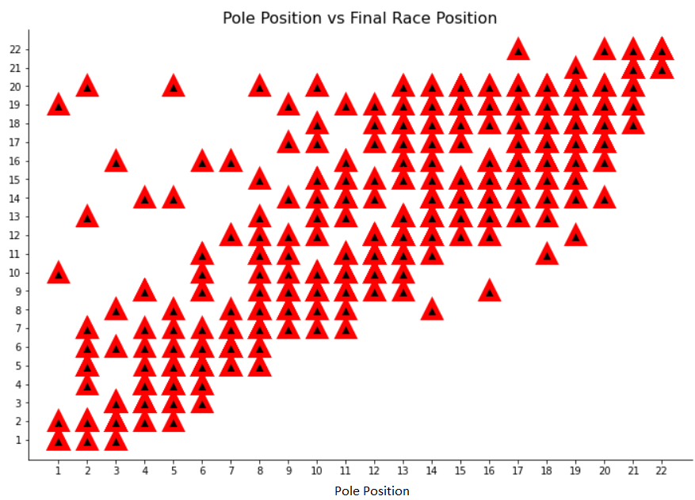

Too soon to celebrate?
Most poles without a title!
Programming for Data Science
2022

Slide 12

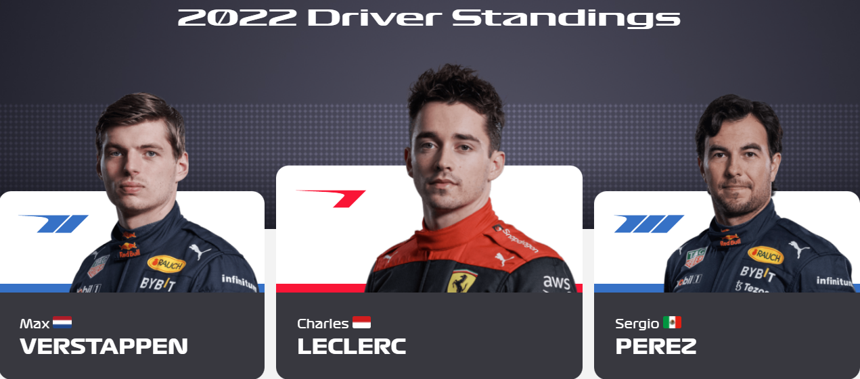
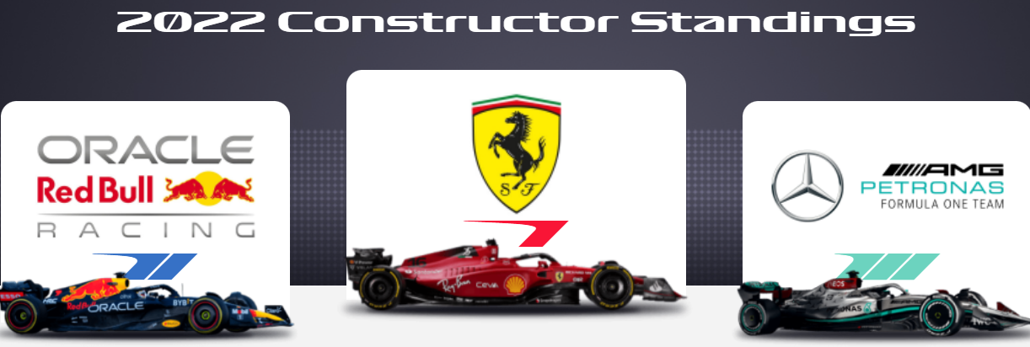
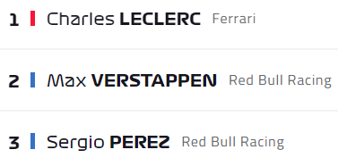
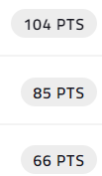
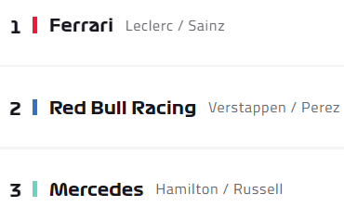
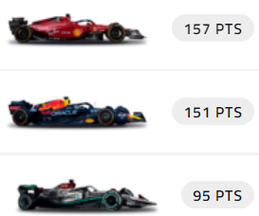
Current F1 season
F1 TV
Programming for Data Science
2022

Slide 13

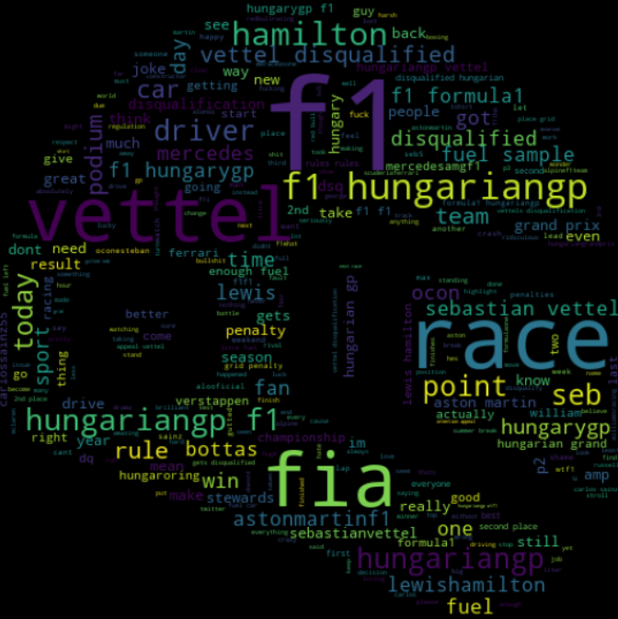

@ f1 tweets
Programming for Data Science
2022

Slide 14
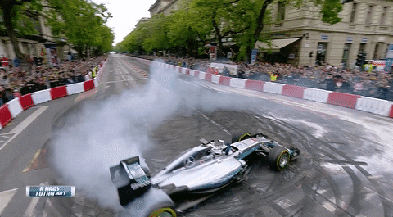

The end
Thank You!!
Questions?
Programming for Data Science
2022

